Slide 2
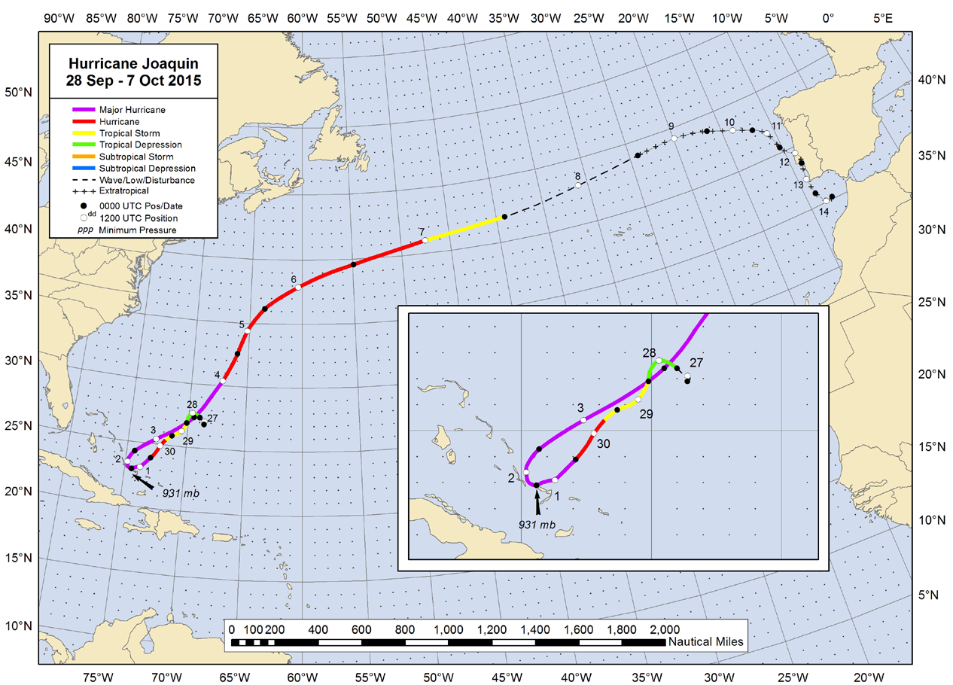
Hurricane Joaquin
Source: http://www.nhc.noaa.gov/data/tcr/AL112015_Joaquin.pdf
Notes:
According to the National Hurricane Center’s Tropical Cyclone Report dated January 12th, 2016, Joaquin’s formation is notable in that the cyclone did not have tropical origins, which is rare for a major hurricane. Moderate north-northwesterly shear prevented the depression from strengthening for about a day, but the cyclone became a tropical storm at 8:00 pm local time on September 28th while centered about 295 nautical miles northeast of San Salvador. A high pressure ridge forced Joaquin to move slowly southwestward, and over very warm waters near the Bahamas. A 60-hour period of rapid intensification began at 2:00 am local time on September 29th. Joaquin became a hurricane at 2:00 am local time on September 30th, and strengthened to a Category 3 (major) hurricane 18 hours later about 90 nautical miles east of San Salvador.

Slide 3
Weather - Voyage Timeline
8:00 PM Sept. 27th: Tropical Depression 11 formed
2:00 AM Sept. 29th: Tropical Storm Joaquin developed
8:27 PM Sept. 29th: EL FARO departs Jacksonville
2:00 AM Sept. 30th: Tropical Storm Joaquin upgraded to a hurricane
8:00 PM Sept. 30th: Cat 3 hurricane with winds estimated at 100 knots
7:17 AM Oct. 1st: Last known position broadcasted from EL FARO
8:00 AM Oct. 1st: Cat 4 hurricane with winds estimated at 115 knots
Notes:
This slide represents the correlation between Hurricane Joaquin’s development and the EL FARO’s final voyage.

Slide 4
Hurricane Categories
Category | Wind Speed (kts) | Wind Speed (mph)
Tropical Depression | ≤ 33 | ≤ 38
Tropical Storm | 34 – 63 | 39 – 73
1 | 64 – 82 | 74 – 95
2 | 83 – 95 | 96 – 110
3 | 96 – 112 | 111 – 129
4 | 113 – 136 | 130 – 156
5 | 137 + | 157 +
Saffir-Simpson Hurricane Wind Scale as presented on the National Hurricane Centers website
Notes:
For perspective, presented here are the wind speeds for the adopted Saffir-Simpson Hurricane Wind Scale. This is provided for reference.

Slide 5
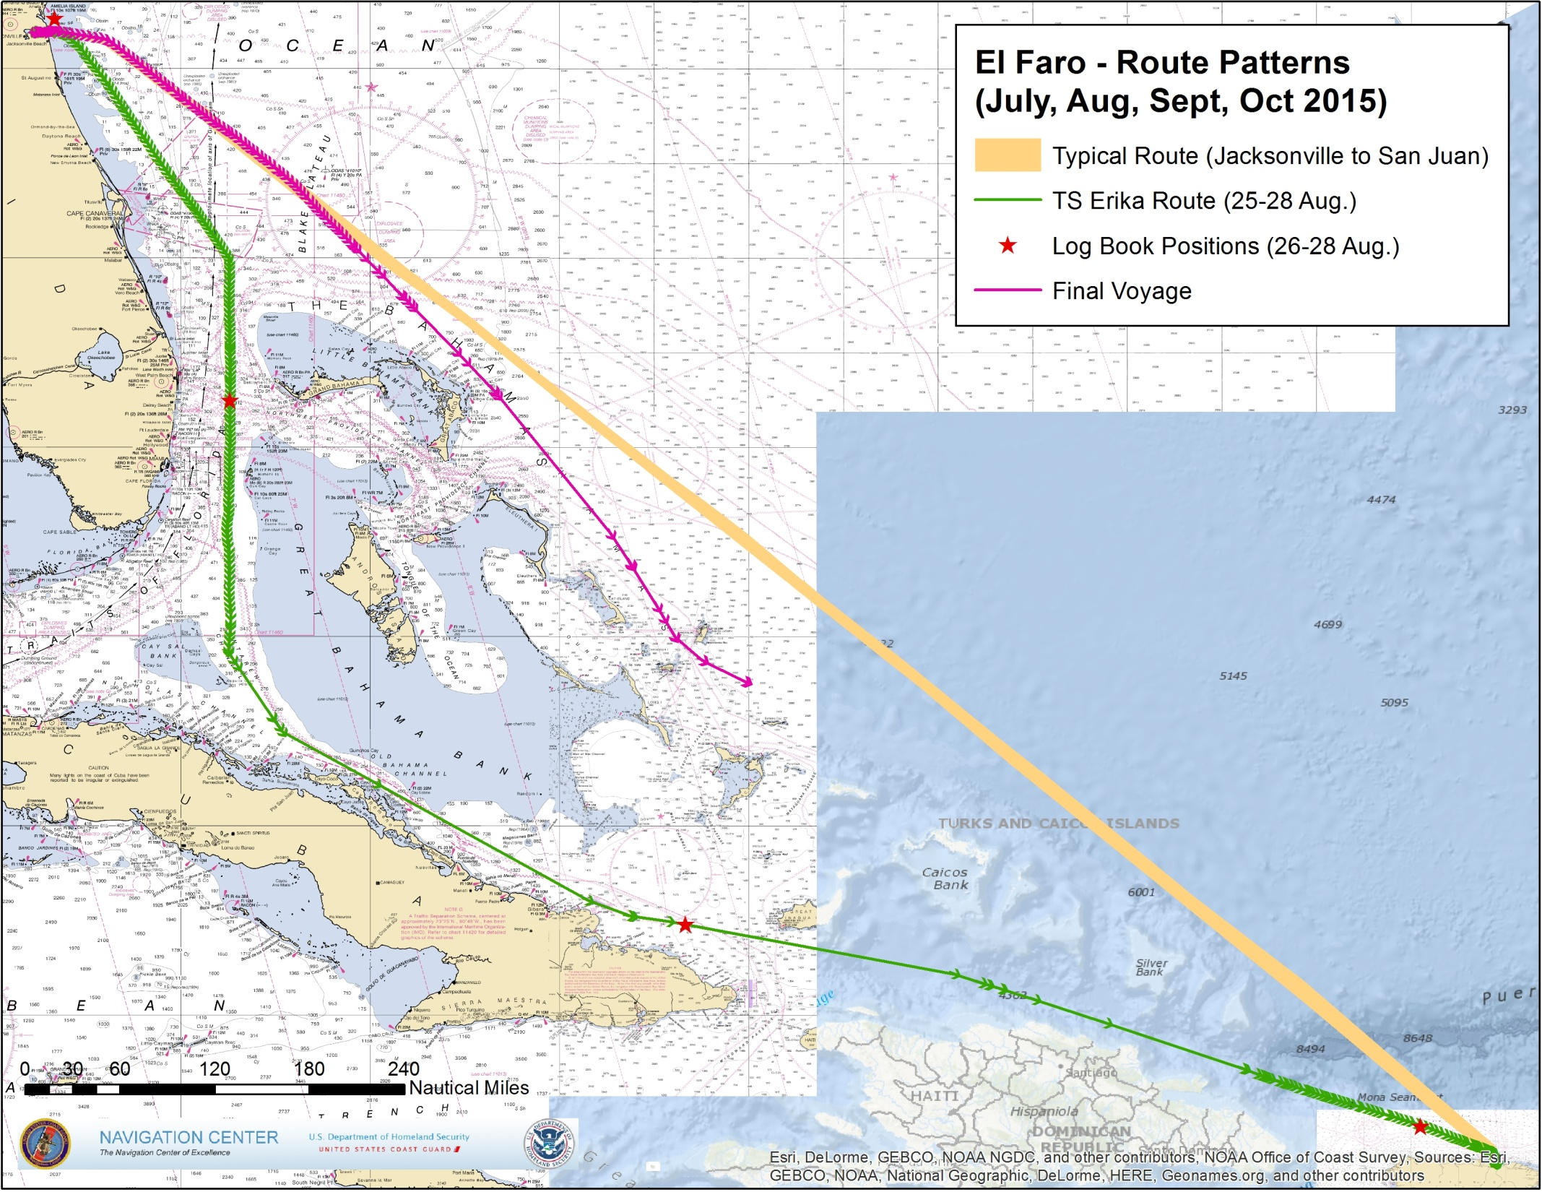
Notes:
EL FARO’s typical route from Jacksonville, FL toSan Juan, PR, shown in a brown, is the most direct and economical route, to the east of the Bahamas. During the time period for Tropical storm Erika, the EL FARO took a longer, more southerly route, shown in green, passing through the Florida Straits then transiting east by southeast through the Old Bahamas Channel. The red stars on this route are taken from EL FARO’s ship’s logs. This route will be addressed in a later slide. The EL FARO’s final voyage is shown in magenta. All three tracks are derived from recorded National Automated Identification System (NAIS) data.

Slide 6
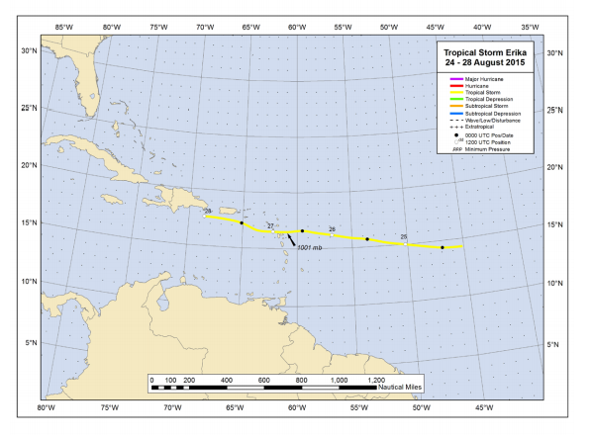
Tropical Storm Erika
Source: http://www.nhc.noaa.gov/data/tcr/AL052015_Erika.pdf

Slide 7
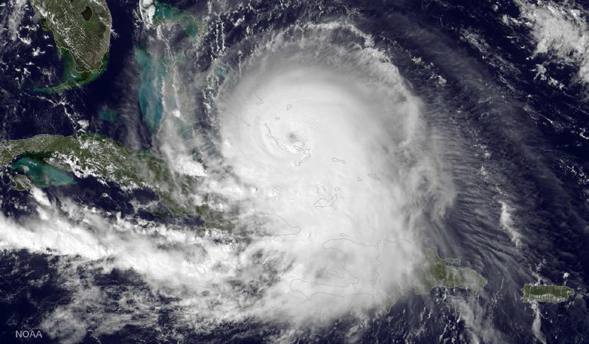
Geostationary Operational Environmental Satellite (GOES) imagery of Joaquin
taken about 3 PM EST on October 1st, 2015
Notes:
Hurricane Joaquin was a Category 4, Major Hurricane that reached peak intensity between the 1st and 2nd of October. The storm traveled an unusual southwesterly route and took a sharp turn back to the northeast. Damages to personal property throughout several islands in the Bahamas, including South Long Island, Crooked Island, Acklins, Rum Cay, San Salvador, may-guana, and Eggs-zoom-uh, have been directly attributed to Joaquin. The Bahamas reported that those damages exceeded $60 million U.S. dollars. Other naitons including Turks and KAY-COS, Cuba, Haiti, and Bermuda reported damages sustained from flooding. 34 persons are known to have perished at sea in the storm; 1 fisherman off the coast of Haiti, and the 33 persons aboard the SS EL FARO.

